Slide 1


WAS: Weighted Aging Shortest
A New CPU Scheduling Algorithm
Team Members:
Sushanth P(AP23110010989)
Chashmitha P(AP23110011087)
Rishi Kumar(AP23110011088)
Reethu Priya M(AP23110011128)
Olive Chaitanya M(AP23110011192)

Slide 2

Introduction to CPU Scheduling
CPU Scheduling is fundamental to operating systems, impacting performance and user experience by determining which process accesses the CPU next.
Traditional Algorithms
Inherent Issues
SJF, SRTF, and HRRN are foundational concepts.
Each algorithm has problems like starvation, excessive context switches, or non-preemptive delays.
Our Goal
Develop a balanced scheduler for fairness and responsiveness.

Slide 3

Critique of Existing Algorithms
SJF (Shortest Job First)
Prioritizes shortest burst times, but can starve longer processes.
SRTF (Preemptive SJF)
Efficient for short tasks, but frequent context switches and starvation risk for longer processes.
HRRN (Highest Response Ratio Next)
Reduces starvation by considering waiting and burst time, but non-preemptive nature delays new short jobs.

Slide 4
The Imperative for a New Algorithm
A balanced approach is needed for CPU scheduling.
Prevents Starvation
1
Ensures all processes get CPU time.
Is Preemptive
2
Allows high-priority tasks quick CPU access.
Good Turnaround Times
3
Balances process completion with system efficiency.
Simple & Understandable
4
Facilitates easier implementation.
Adjustable Behavior
5
Flexibility for diverse system requirements.
✨ This leads to our innovative solution → WAS (Weighted Aging Shortest) ✨

Slide 5


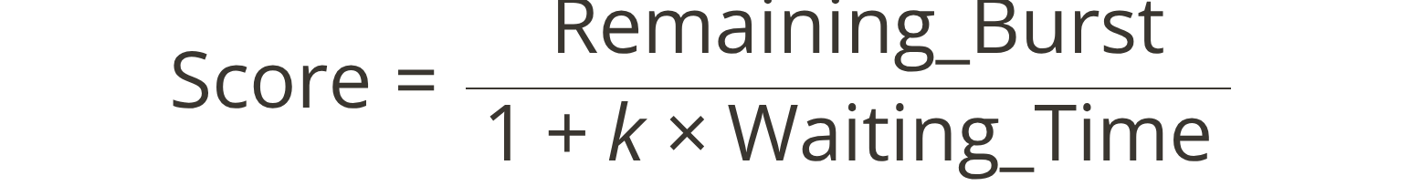
Proposed Algorithm: WAS
The Weighted Aging Shortest (WAS) algorithm is a preemptive scheduling algorithm designed to address traditional scheduling shortcomings through dynamic priority.
Key Idea
Score Formula
WAS selects the process with the lowest age-adjusted score for execution, ensuring fairness over time.
A lower score indicates higher priority. The aging constant 'k' (0.2 to 1.0) boosts priority for long-waiting processes, preventing starvation.

Slide 6

How WAS Works: Operational Dynamics
Core Rules
Key Advantages
Preemptive: CPU reallocated if a new or aged process has a lower score.
Rapid Short Task Completion: Low initial scores service short burst processes quickly.
Dynamic Score Updates: Scores recalculate upon arrival, completion, or quantum points.
Elimination of Starvation: Aging factor dynamically increases priority for long-waiting processes.
Tie-breaker: Higher waiting time, then lower Process ID (PID).
Fine-Tunable Behavior: 'k' constant adjusts bias towards fairness or responsiveness.

Slide 7
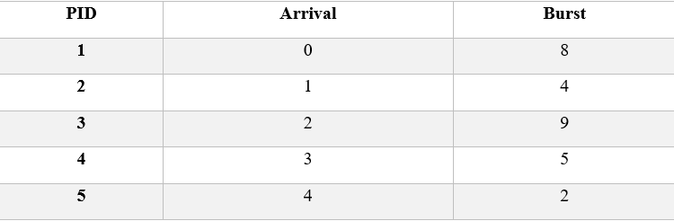
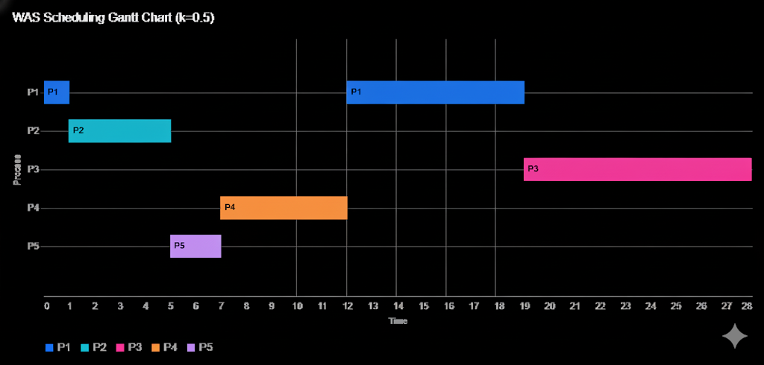
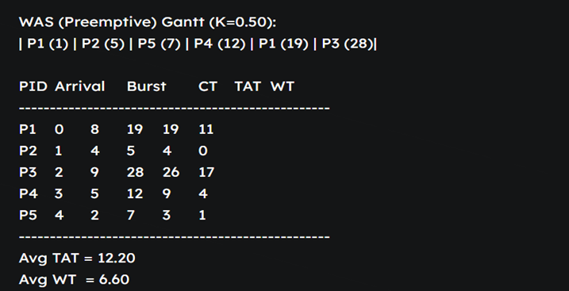
Example Processes (AT/BT Values)
Gantt chart
Turnaround Time (TAT) & Waiting Time (WT) Comparison

Slide 8
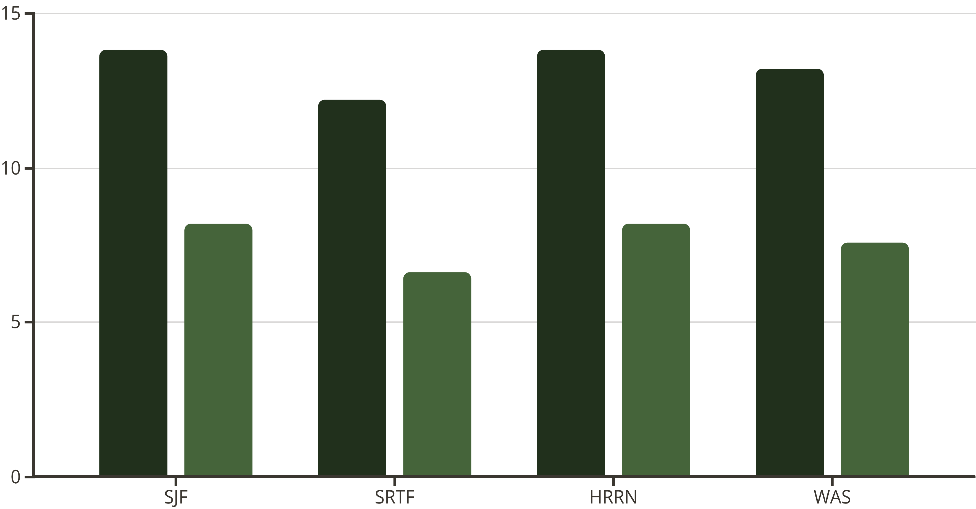
Results Comparison: Performance Metrics
Average Turnaround Time (TAT)
Average Waiting Time (WT)
WAS achieves performance remarkably close to SRTF, improving fairness and stability by mitigating starvation.

Slide 9










The Superiority of WAS
Balanced Fairness & Efficiency
Preemptive & Responsive
Optimizes throughput and equitable resource distribution.
Quick reaction to high-priority tasks.
No Starvation
Aging mechanism guarantees all processes are served.
Simple, Formula-Based
Comparable to SRTF
Easy to implement and understand.
High performance without starvation issues.
Ideal for systems prioritizing fairness and real-time operations.

Slide 10

Conclusion: The Future of CPU Scheduling
WAS represents a significant step forward in addressing long-standing challenges in CPU scheduling.
Enhanced Strengths
Combines efficiency of SJF/SRTF with fairness of HRRN.
Validated Performance
Superior or comparable to standard algorithms.
Starvation Prevention
Integrated aging mechanism guarantees no indefinite delays.
Tunable Responsiveness
'k' value offers flexible control for system requirements.
Thank you for your attention!

